Slide 1
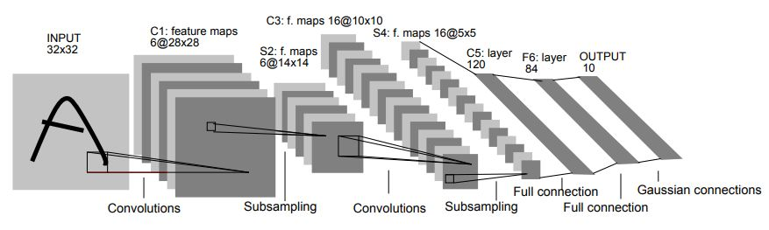
Artificial Neural Networks and Image Classification
By Max Hicks
LeNet-5

Slide 2
The Focus Of The Investigation
The focus of this investigation was to explore the concept of what neural networks are and investigate applications of these biologically inspired computer programs.
The problems we explore in the paper are that of decision and of classification. Both of which are examples of supervised learning which is the type of learning explored in this investigation.

Slide 3
An Introduction Into Neural Networks
First, we must define what a neural network is. A neural network is a computer program that is modelled on the learning process of our biological brains. We can then think of this network as a large net of inter-connected neurons that can exchange information. In the case of the networks we explore in this investigation these will exchange information via a feed-forward mechanism. This means that all information given to this network will only travel forward through the network.

Slide 4
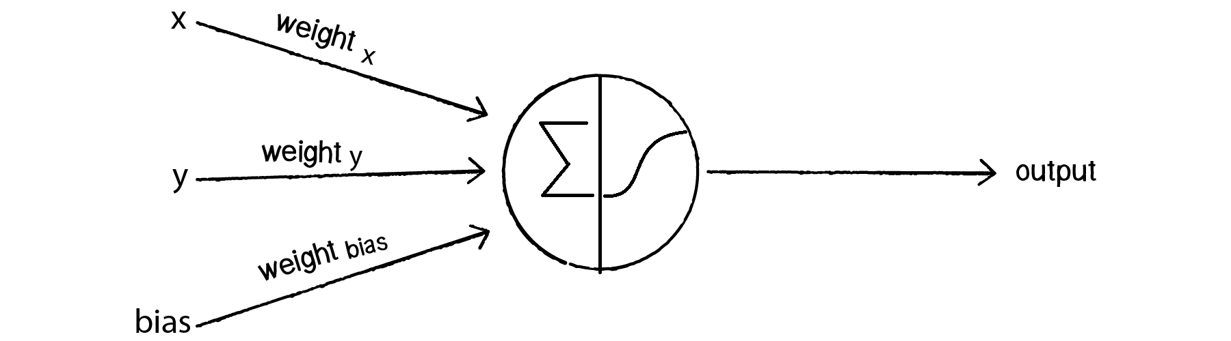
What Comprises A Neural Network?
We should touch on what a neural network is comprised of, what it looks like and how the basic learning process works.
In figure 1 we can see what is an SLP network, an SLP network is a good starting point for braking down each component of a basic neural network, we will later touch on this type of network following our theory of these components.
What we can see in figure 1 is we have a weighted sum of x and y along with the addition of our bias noting the value of the bias is usually a fixed value of 1. You may also see this bias referred to as the threshold.
After we have computed our weighted sum, we pass it into our activation function denoted by the sigmoidal sign in figure 1. This will give us an output in which we can calculate the error from our loss function.
We should now move on to analysing all these components individually to better understand what the purpose of these components are.
Figure 1

Slide 5
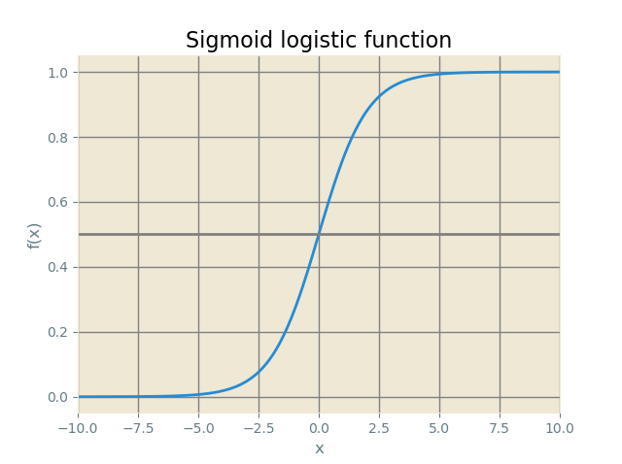
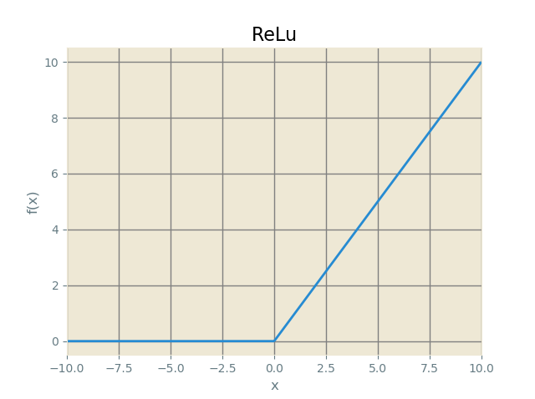
Neural Network Theory Part 1: Activation Functions
As mentioned before activation functions are a crucial part of artificial neural networks and determine how information is forward propagated through the network.
Important features of a good candidate for an activation are that it should be monotonic, usually monotonically increasing ensuring that the network behaves appropriately for large input values.
We will talk about two activation functions here as they will be used later in our implementation. These two functions are the logistic sigmoid and the rectified linear unit or ReLU function.
In figure 2 we can see the logistic sigmoid function. The logistic sigmoid can be used within hidden layers of a network or on the output layer as it can return values between 0 and 1 which is useful for getting the probabilities of a correct classification.
However it suffers from the vanishing gradient problem. This is a problem that for large values on the input of the function can cause the learning process to stop as the gradient becomes effectively 0 for large inputs. Such a neuron that exhibits this is sometimes called saturated.
Below in figure 3 is the ReLU function. This function is much cheaper to compute compared to the sigmoid function and maintains forward propagation of data better due to the lack of vanishing gradients.
It does however suffer from one problem. This being the dying neuron problem where for negative values the ReLU function outputs 0. This becomes a problem if there is a very large but negative weight on the synapse of a given node with a ReLU activation. This leads to the neuron outputting 0 and thus halting the neurons learning process entirely as well as leading to decreased network performance.
This can be solved either by sensibly initialising weights or by using a leaky ReLU function which has a slight positive gradient for negative values of the input.
Figure 2
Figure 3

Slide 6
Neural Network Theory Part 2: Loss Functions
Loss functions are perhaps the most crucial element of a neural network as the correct choice of loss function is how we measure the error of a given prediction. Typically loss functions are sorted into a couple of different categories. These would be regression or classification.
As discussed in the paper in it should be noted that some classification problems are regression problems in disguise. This means we can get away with using something like the mean squared error for certain classification problems.
But why use a loss function at all? Why not just count the sum of the total error? If we count the total error this will lead to a seriously hamstrung learning process. What we are telling the program to do is to minimise the loss. If we tell our program minimise the total error, we may have a situation where we have 1 very wrong classification with lots of perfect classifications may be a total lower error compared to a batch of results with very small errors. We can see this in section 3.4.1 in the paper. However if we square these errors, we can see just how large an error we have. This can result in a dataset of pretty good loss values being incentivised over a dataset with a very wrong classification.

Slide 7
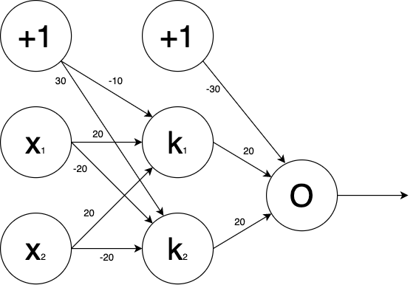

Neural Network Theory Part 3: Backpropagation
What we mean by backpropagation is the backpropagation of error. This is how we begin the learning process by updating our weights according to this formula: $θ_{t+1}=θ_{t}−α\left(\frac{∂L }{∂θ}\right)$.
This equation is a more generalised version of our equation in the paper when talking about the backpropagation for an SLP network. $θ_{t}$ is our weight tensor and the iteration t, it contains various weight vectors $w_{ij}^{k}$ where “i” the index of a neuron in our layer k, “j” is the connection to the j’th neuron in the k+1’th layer.
So for example let’s take our XOR solver network from the paper in figure 4. So the first neuron in the first layer has connections $W_{1,1}^{1}and$ $W_{1,2}^{1}$ respectively ( these are the connections to $k_{1}$ and $k_{2}$).
Now since the backpropagation rule is derived from the chain rule this leads to further explain why the vanishing gradient problem is so bad in deep networks as you will have multiple small gradients being multiplied together leading to $\frac{∂L}{∂θ}$ to be effectively 0.
Figure 4

Slide 8
Neural Network Theory Part 4: Optimisation
Optimisation is about learning rate auto adjustment. The learning rate controls just how much of our error gets backpropagated through the network. Set it to high and we will find divergent behaviour in our network as the change in the weights is too drastic for convergence. If set to a value which is too small, we will have issues with the speed of convergence.
On small networks it may be all well and good to set this learning rate to constant of usually 0.1 or 0.01. However in deeper networks we need a more sophisticated approach to achieve better convergence speed.
The main optimisation method explored in our investigation is the ADAM algorithm which stands for Adaptive Moment Estimation. This algorithm is actually a combination of both RMSProp and Momentum based optimisers.
The actual mathematic equations that govern these algorithms is discussed in section 3.5.1

Slide 9
The Beginnings Of ANN’s: The SLP
The earliest form of something that resembles a neural network is the perceptron. Now the simplest implementation of a perceptron is a single layer perceptron network or SLP.
An SLP network can take any number of inputs one of which is the bias term. This term is usually a value of 1.0 which also has its own weighted synapse associated with it.
All the input nodes are then connected to an output node which has something called an activation function inside it. This activation controls the output value of our network. In our case of classification this will usually be a probability value.
We can see in from our previous figure (figure 1) what this looks like. First, we sum each input with its respective weight along with the bias term. We then pass it into the activation function and collect our output. What we then do with our output is pass this into a very crucial part of our network that being the loss function.
The loss function is how we will compute how correct our classification is and how we will backpropagate this through our network.
One downside of an SLP network is its inability to separate non-linear datasets. This is seen with the XOR gate problem first brought up by Minsky and Papert in 1969.

Slide 10
The MLP
The next step in the evolution of the neural network was the MLP or multi layered perceptron. This type of network is similar in its operating principal to the SLP however it has an added advantage in that It can separate non-linear datasets.
However while we can use an MLP to separate simple non-linear datasets like the XOR dataset. We can instead use it for far more complicated datasets made up of images and begin to classify them.
However there are again limitations to the MLP model. For example one disadvantage is that an MLP starts to perform worse for images that start getting larger, somewhere in the range of the hundreds of pixels. This is because we are looking at each individual pixel's colour value (between 0 and 1) and this can lead us to having a huge number of nodes per layer which will lead to extremely slow convergence or even worse, no learning happening at all.
Another is the lack of spatial invariance. MLP are not spatially invariant, this includes things like the image being rotated or shifted. Therefore if an object does not appear in roughly the same location as it identified before it will not be able to tell what it is as it conflates location in space with the classification.

Slide 11
An Upgrade To The MLP: The CNN
CNN’s or convolutional neural networks solve the two crucial issues we had mentioned before with MLP architectures. This is because of a difference in principle. What a CNN incorporates is something called a kernel sometimes called a filter for a kernel that has a specific use.
A kernel or filter that is used for image classification takes the form of a grid. This grid strides across the image and reads the colour values of that given pixel. This information is then used as the data for something called a pooling layer. There are two types of pooling layer however we used the more common max pooling layer which picks out the maximum value of this 3x3 grid.
The reason why we begin to pool values like this is to reduce computation time for feature map generation. This also has the advantage of being spatially invariant as we are looking for features based on the values of our pooled pixels and not caring about the surrounding pixels values.
This solves a big hurdle in MLP networks where we can use much larger images and achieve far more reasonable computation times as well as increased accuracy.

Slide 12
Implementation: SLP
The first step in our implementation and analysis is implementing a simple SLP system capable of classifying a data point in cartesian coordinates. We first started by creating a dataset which is an array of arrays with the first index being the x coordinate the second the y coordinate and our third index being our class label used for our correct prediction.
We then created a loop that chooses one of these sub arrays for the purpose of feeding it into our network. We do this twenty thousand times to train our network to gain the correct weights and bias values.
We will notice that the bias actually always takes on a negative value which is actually a natural consequence of the bias being a threshold that the weighted sum has to overcome.
Next we simply calculated the weighted sum for our mystery point’s coordinates and our bias and pass it into our sigmoid function to get its predicted class.

Slide 13
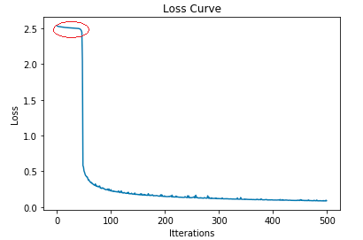
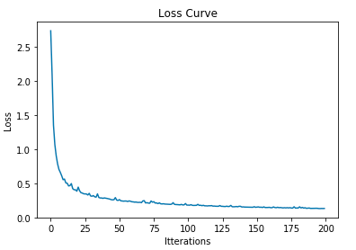
Analysis Of SLP Results
Because this is a very simple network there isn’t much to talk about with regard to the result. But we do see very low loss values with a nice rate of convergence. Diminishing returns start at around the 3000 mark in terms of iterations.
Very infrequently it can actually be observed that the network can actually experience the affects of poor random values being chosen for the weights and bias value as the plot of the loss graph can be seen plateauing at very early epochs however this can be overcome eventually with just more and more iterations.

Slide 14
Implementation: MLP
For the implementation of the MLP network I decided on using the MNIST fashion dataset just as a slight change on the older MNIST digits dataset developed by Yann LeCun, Corina Cortes and Christopher Burges.
This dataset consists of 10 different types of clothing in a 28x28 pixel image format similar to that of the digits dataset.
For this implementation I have opted to use TensorFlow version 2.1.0 which has incorporated the Keras sequential model which makes programming a network architecture much easier than from first principals allowing us to reduce the total lines of code to around 63 lines of codes excluding whitespace.
The first thing we did was load in our data, assign training images and labels as well as validation images and labels from our data. Then we normalise our greyscale values to between 0 and 1.
We are then ready to begin feeding our data into our model which is just an amazingly small 4 lines of code thanks to the power of the Keras API. We can then compile our model and then begin to fit it using the .fit() method. We trained our network for 10 epochs which is a relatively small number of epochs but never the less it is more than enough as we will talk about in our results.

Slide 15
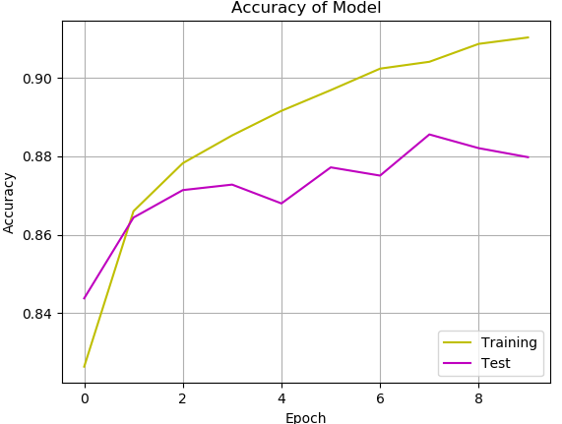
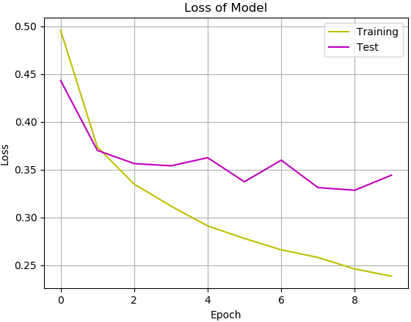
Analysis Of MLP Results
What we found in the output of our model from our MLP network is though we achieved a very good level of validation accuracy we saw that the model was slightly overfitting our data. We can see this as the curve for validation accuracy seems to plateau and stay below our training accuracy.
However there are multiple ways to address this overfitting. One way to combat this problem is by adding a dropout layer. This layer will randomly select a percentage of our neurons to not output any values during training. However during validation this will not be the case and all neurons will output values.

Slide 16
Implementation: CNN Part 1
In this implementation we have focused on using a more complex data set that uses not only larger images but RGB images just to demonstrate how much more powerful a CNN can be.
We again use TensorFLow for this implementation for the same reasons as before. However now we must reshape our data because not all the images are the same size. However our target size is a 150x150 image.
The reason for choosing this dataset as opposed to using the same dataset again but this time in a CNN is because this dataset would be almost impossible to train with on an MLP because of the lack of spatial invariance. However as noted previously this is not problem for our CNN and we can cope with objects being in different positions across the screen.
For this first implementation, no transformations in the data were made and a simpler model was used. Just to see a baseline to where we can improve from.

Slide 17
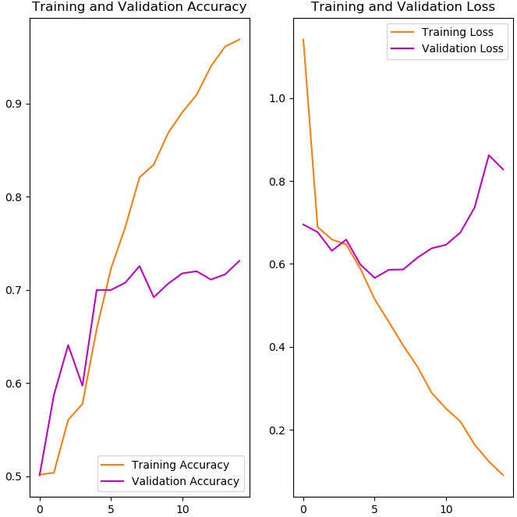
Analysis Of CNN part 1
We could see from the Accuracy and loss graphs that we were not really achieving good accuracy with our data and we also ran into a larger amount of overfitting this time. We also ran into another phenomenon whereby both accuracy and loss were increasing.
The reasoning behind this is because while borderline cases, i.e cases near 0.5 were being changed to be correctly classified. Other bad cases were being classified even more incorrectly.
The solution to this problem, working with the rather small dataset that we have is to start applying transformations to our data. Also changing our architecture to combat this overfitting problem once more.

Slide 18
Implementation: CNN Part 2
This will be our final implementation for our image classifier. We will use a few techniques to improve upon our first run of the CNN.
To do this we will apply several transformations such as; shifting, flipping (horizontal flipping only), shearing, zooming and finally rotating. We will apply this to our images as to account for the size of the data set which is relatively small and to help improve accuracy.
We also have a more complex architecture than before as we make use of dropout layers to help reduce some amount of the overfitting.

Slide 19
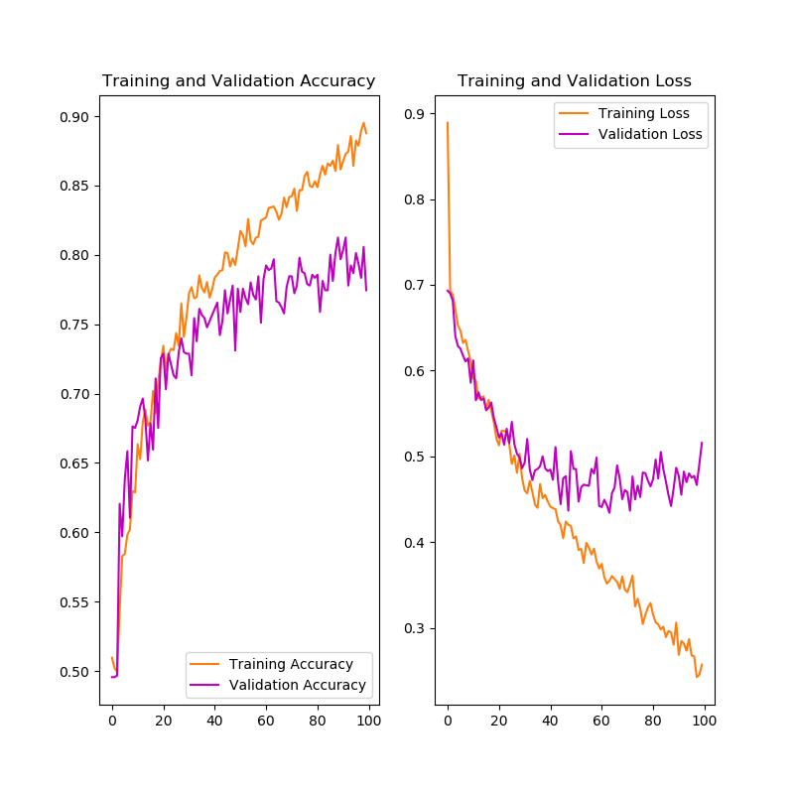
Final Results
The final results were certainly an improvement over the previous example as we have gained about 10% in accuracy almost to the 80% mark. Now this is good, but it is not that brilliant. We can still see plateauing in accuracy and loss graphs and once again run into the phenomenon of accuracy increasing with loss.
There are ways to perhaps improve this result. We could use batch normalisation layers to prevent neuron saturation, what this layer does is make sure all activations are normally distributed. We could try incorporating a learning rate scheduler which periodically spikes the learning rate in order to find the global minimum on our error surface.
But most importantly we could try using a larger dataset. This dataset only has about 3000 images, 2000 for validation and 1000 for testing. There is a larger data set available which consists of 25000 images, 20000 for training and 5000 for testing.
However the main reason for not using this dataset was not out of choice but because of a technical limitation with the resources at hand. It simply took a very long time to perform this on the machine used to run this network and a larger data set would have taken far longer.

